Slide 1
Database Design Wednsday 6:20 to 8:50
Bohdan Hawryluk
System Architect
Weill Cornell Medical College

Slide 2
DBMS
MIDTERM 30%
FINAL 30%
PROJECT 30%
PARTICIPATION AND HW 10%

Slide 3
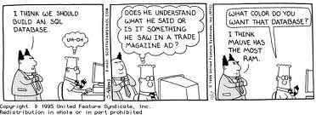
RDBMS

Slide 4

RDBMS

Slide 5

RDBMS

Slide 6

RDBMS

Slide 7

RDBMS

Slide 8





RDBMS

Slide 9
RDBMS
Data is stored in tables and the relationships among the data points are also stored in tables.
Relationships are governed by Primary Foreign key relationships and are strictly enforced.
The data can be accessed or reassembled in many different ways without having to change the table forms.
Methods of storing data are governed by 6NF

Slide 10
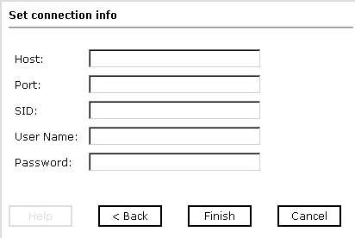
RDBMS

Slide 11
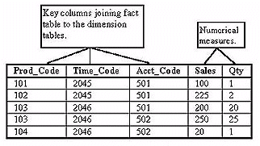
RDBMS

Slide 12
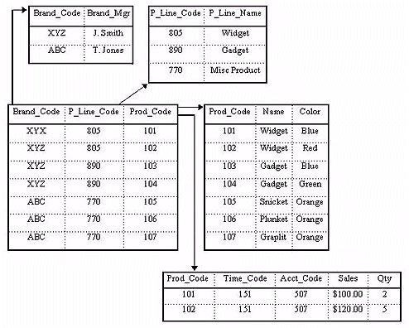
RDBMS

Slide 13
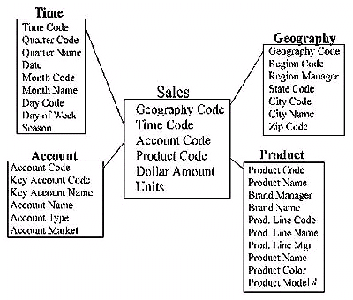
RDBMS

Slide 14
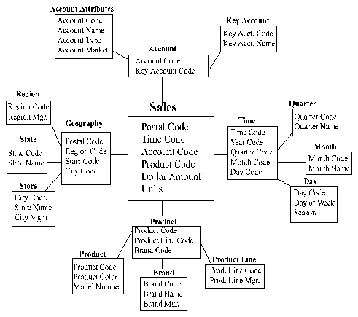
RDBMS

Slide 15



RDBMS

Slide 16
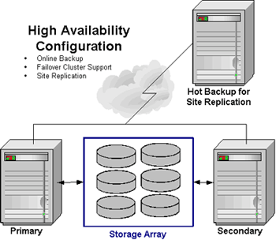
RDBMS

Slide 17
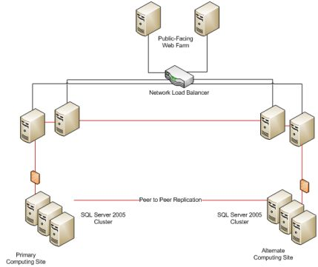
RDBMS

Slide 18
NORMALIZATION
1NF
2NF
3NF
4NF
5NF
6NF

Slide 19
SQL
SQL – Structured Query Language
Data Definition Language (DDL)
Data Manipulation Language (DML)
Data Control Language (DCL)

Slide 20
SQL DDL
CREATE
ALTER
TRUNCATE
DROP
INDEX

Slide 21
SQL DML
SELECT
FROM
WHERE
ORDER BY
GROUP BY
HAVING
INSERT
UPDATE
DELETE

Slide 22
DML
LEFT JOIN
RIGHT JOIN
INNER JOIN
SELF JOIN
CARTESIAN PRODUCT

Slide 23
DCL
GRANT
REVOKE

Slide 24
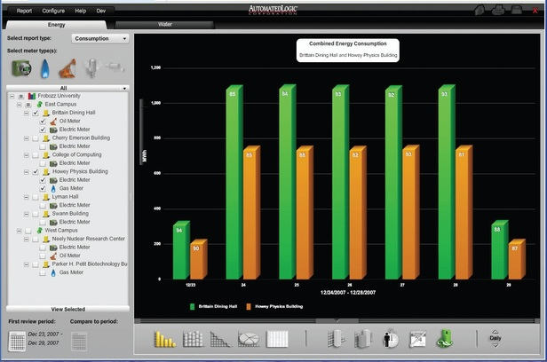
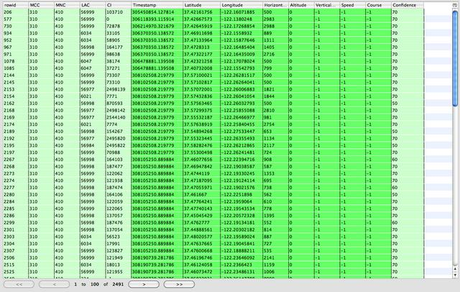

FUNCTIONS

Slide 25
FUNCTIONS
SUM
AVG
COUNT
LTRIM
RTRIM
MIN
MAX

Slide 26
DATA TYPES
INTEGER
VARCHAR
CHAR
DATE
TIMESTEMP

Slide 27
ADVANCED TOPICS
CURSOR
BACKUPS
STORED PROCEDURES
VIEWS

